Slide 1
HudsonAlpha BioTrain Computational Bootcamp
James Lawlor
Computational Biologist, Greg Cooper’s Lab
HudsonAlpha Institute for Biotechnology
June 2022

Slide 2



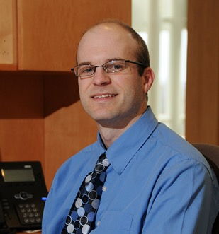
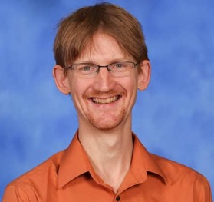
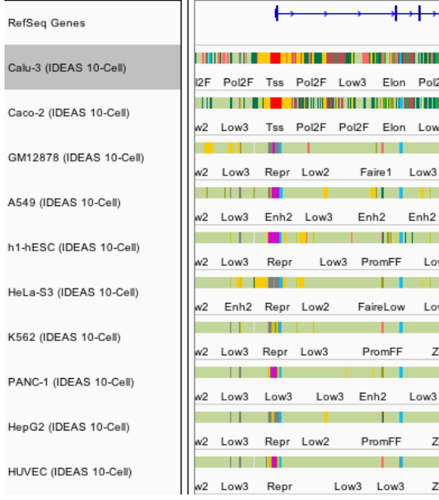
About James Lawlor
B.S.: Biochemistry & Mathematics
M.S.: Modeling & Simulation
Greg Cooper Lab
HudsonAlpha
Computational Biologist
Advisor: Eric
Mendenhall
Notes:
One-minute version of my career path
Got my undergrad degree at UAH, where I knew I wanted to study science and make that into a career path, but wasn’t quite sure which direction I wanted take that
Took a few years to work in industry, doing cost analysis for the DoD
Masters in M&S at UAH:
Worked with Eric Mendenhall and studied the regulation of the CFTR gene
Integrated and optimized several machine learning tools to predict different patterns of CFTR gene regulation in different cell types, with the goal of being able to find enhancers and other genetic elements that cause CFTR to be highly expressed in some types of cells and minimally expressed in others
That opened up the opportunity for me to go work as a Computational Biologist with Greg Cooper’s Lab at HudsonAlpha, where we use genome sequencing to diagnose pediatric rare disease, especially DD/ID
So, I write software and analyze genome sequencing data to help us ask and answer questions about the genetic cause of disease
But how did I get here today? I think that’s fun to point out, because it stems a lot from one of my hobbies, which is patient advocacy for Cystic Fibrosis, which has given me some great opportunities to connect with other adults with CF like myself, including Xan Nowokowski. After Xan and I connected at a CF Foundation virtual event, we began talking about our respective science and research careers, and they were kind enough to bring me here to speak

Slide 3
Why seek genetic diagnoses?
Notes:
* Why seek genetic diagnoses when we are already treating the symptoms of a disorder?

Slide 4
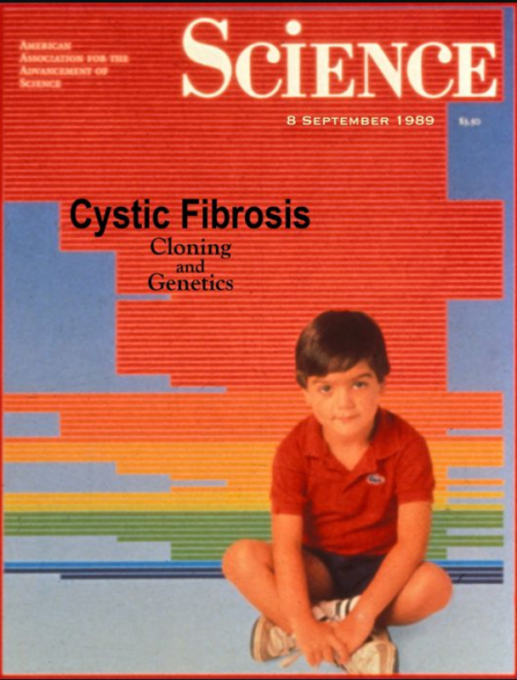
Disease-gene relationships are critical to scientific advancement & treatment
Basic Science: CFTR. (2017). Retrieved from http://www.hopkinscf.org
Notes:
But first I want to pause and reiterate why this basic science that does the work of linking new diseases to genes is so important. In my own life as a CF patient, I’ve been able to witness the direct impact of knowing precisely how a congential disease is affecting the patients on a genetic and molecular level. CFTR, the causative gene for Cystic Fibrosis, was found in 1989, and we eventually learned that it encodes a chloride channel whose malfunction causes the thick mucus that is the hallmark of this disease. This understanding has been critical to a majority of the treatments that I use every day. And that’s why

Slide 5
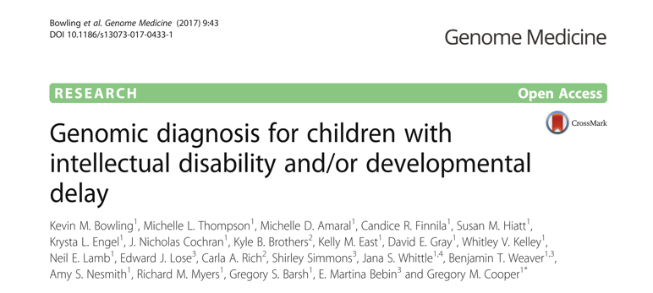
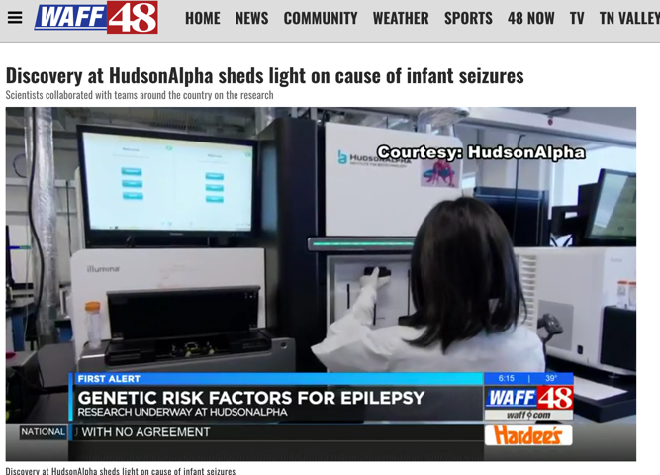
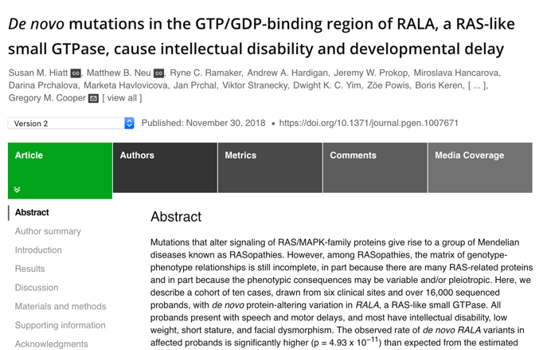
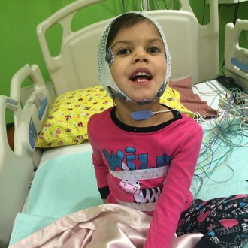
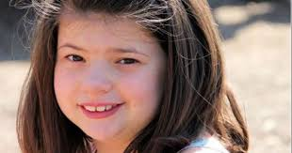
Disease-gene relationships are critical to scientific advancement & treatment

Slide 6


Developmental Delay Diagnosis
Sequence affected individuals + parents
> 800 affected individuals sequenced
Re-analyze cases every ~2 years

Slide 7

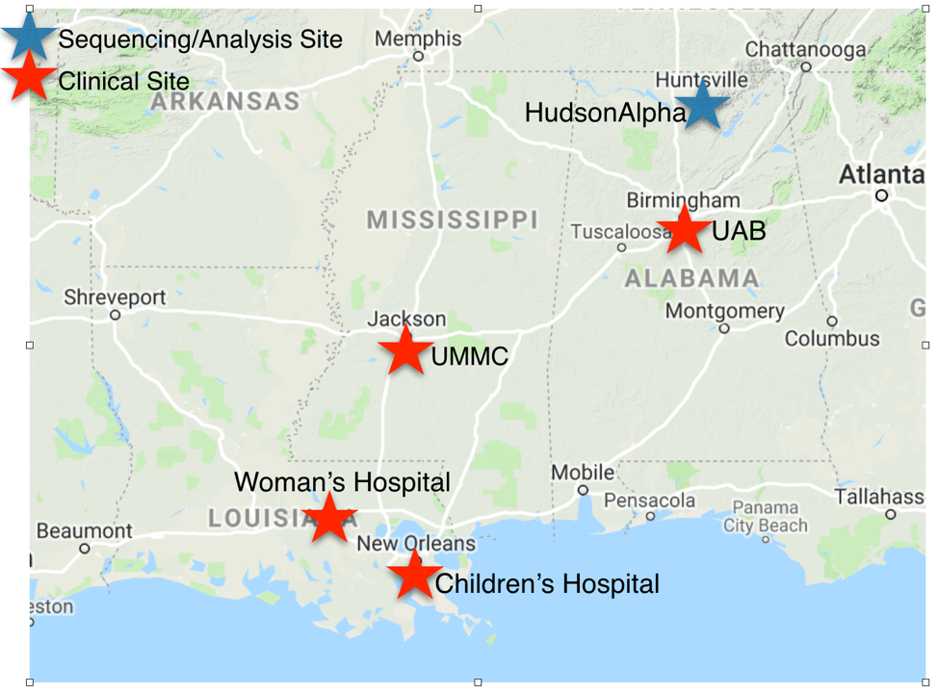
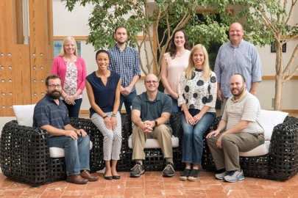
SouthSeq: Genomic Diagnoses for Newborns
Sequence ~1,500 newborns w/ congenital anomalies
Spare patients diagnostic odyssey
Minority / rural focus
Greg Cooper Lab, HudsonAlpha

Slide 8
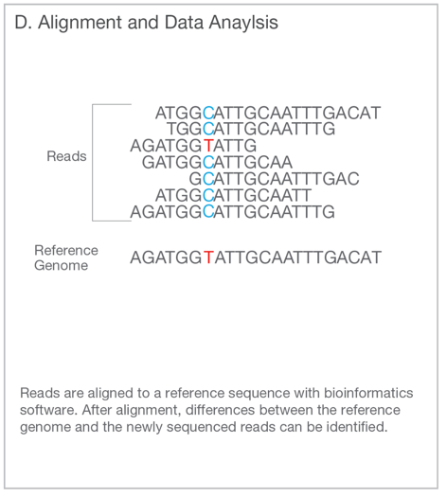
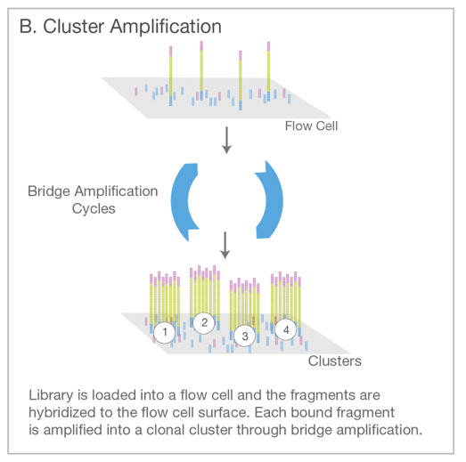
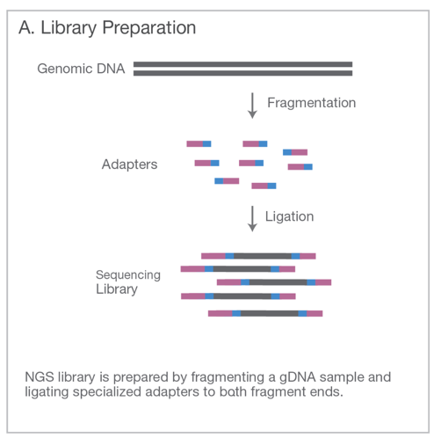
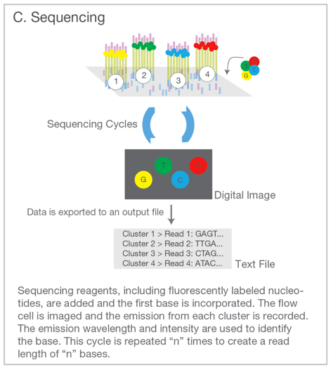
Genome Sequencing (Short Read)
Illumina. An introduction to Next-Generation Sequencing. (2017).

Slide 9

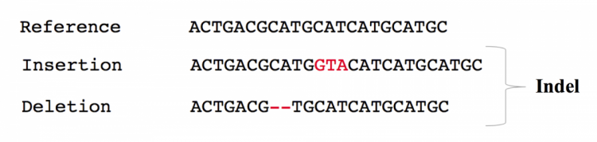
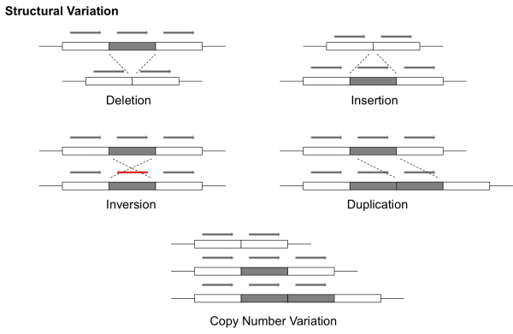
Result: Millions of variants for each person
Each kind of variation requires a different algorithm (or multiple algorithms) to detect from short read data.
EMBL. EMBL-EBI Training (2019).
Notes:
Since our focus is inherited disease, we’re looking at a patient’s DNA

Slide 10
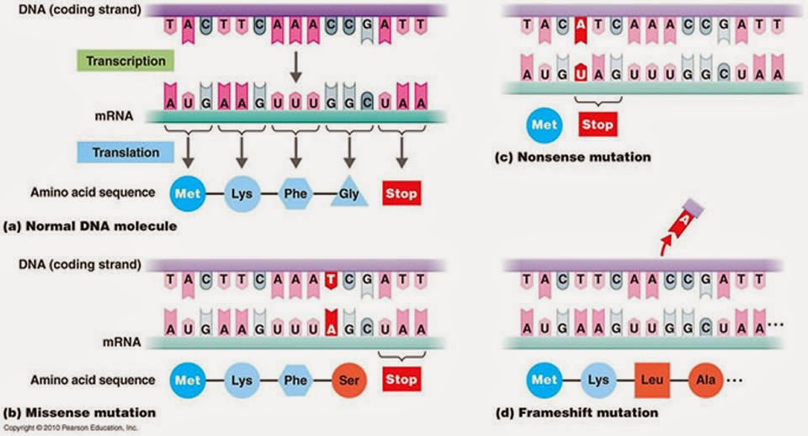
Best-understood variants alter proteins

Slide 11
Filtering / Analysis / Interpretation is key
~4,000,000 variants
population frequency
genomic annotations
computational predictions
inheritance pattern
clinical disease databases
phenotypes
published literature
~1 causal variant
We evaluate the totality of existing evidence for a particular variant

Slide 12
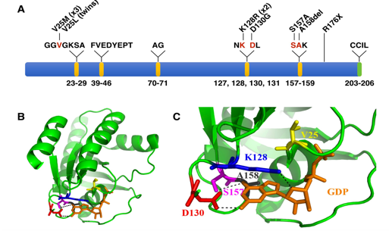
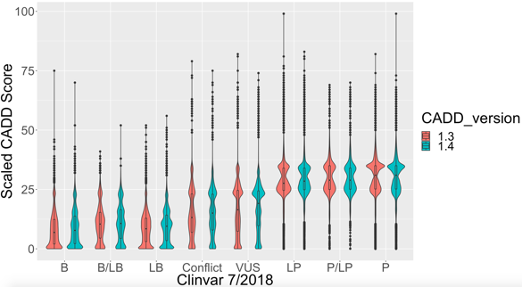
Our Goal: Increase Diagnoses
Describe new disease genes
Analyze more types of variation
Evaluate & improve computational models

Slide 13
Long-Read Sequencing
Focusing on neurodevelopmental diagnoses

Slide 14
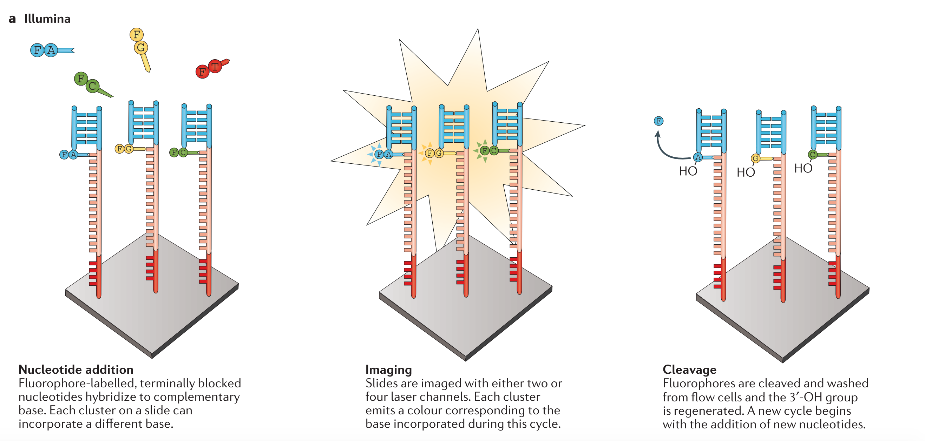
Typical “Short Reads” – 150bp at a time
Notes:
Do a lot of fancy chemistry to:
Break a DNA sample up into random fragments
Attach each fragment to a glass slide and synthesize a template by adding fluorescently-tagged bases one at a time
Image the fluorescent molecules and convert the picture into sequences of each fragment
Typically sequencing about 150 bp on the end of each fragment

Slide 15
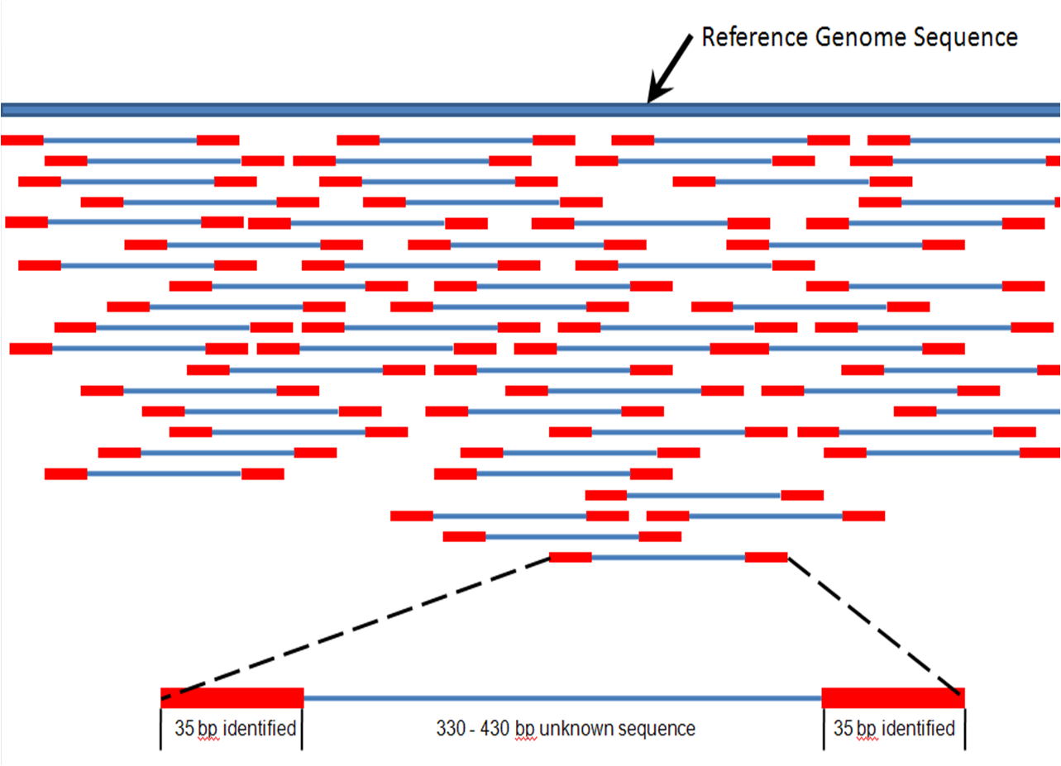
Alignment to Reference Genome
150 bp
150 bp
Notes:
Now that we have hundreds of thousands of short, paired sequences, we can align those short sequences to the reference genome
Reads should be scattered around like this so that every part of the genome is covered 10 to 40 times

Slide 16
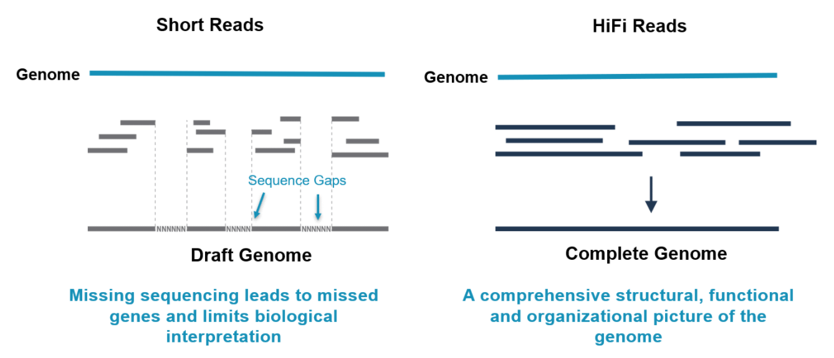

Benefits of Long-Read sequencing
(150 bp)
(10,000-20,000 bp)
Longer reads → better alignment to the genome → more accurate variant calling

Slide 17
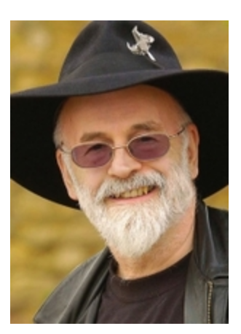
Repetitive Sequence Is Tough for Short Reads
Reference
K | I | W | I | B | A | N | A | N | A | A | P | P | L | E
 |  |  |  | B | A | N
 |  |  |  | B | A
 |  |  |  | B | A
 |  |  |  | B | A
 |  |  |  |  | A | N | A
 |  |  |  |  |  | N | A
 |  |  |  |  |  | N | A
 |  |  |  |  |  | N | A
 |  |  |  |  |  | N | A
 |  |  |  |  |  | N | A
 |  |  |  |  |  | N | A
 |  |  |  |  |  | N | A
 |  |  |  |  |  | N | A
 |  |  |  |  |  | N | A
 |  |  |  |  |  | N | A
 |  |  |  |  |  |  |  | N | A | A
 |  |  |  |  |  |  |  | N | A | A | P
 |  |  |  |  |  |  |  |  | A | A
 |  |  |  |  |  |  |  |  | A | A
Patient Sequence:
Banana?
Bananananana?
Banaannaannaannaan?
Bana?
Ananab?
Reads
“Nanny Ogg knew how to start spelling 'banana', but didn't know how you stopped.”
― Terry Pratchett, Witches Abroad

Slide 18
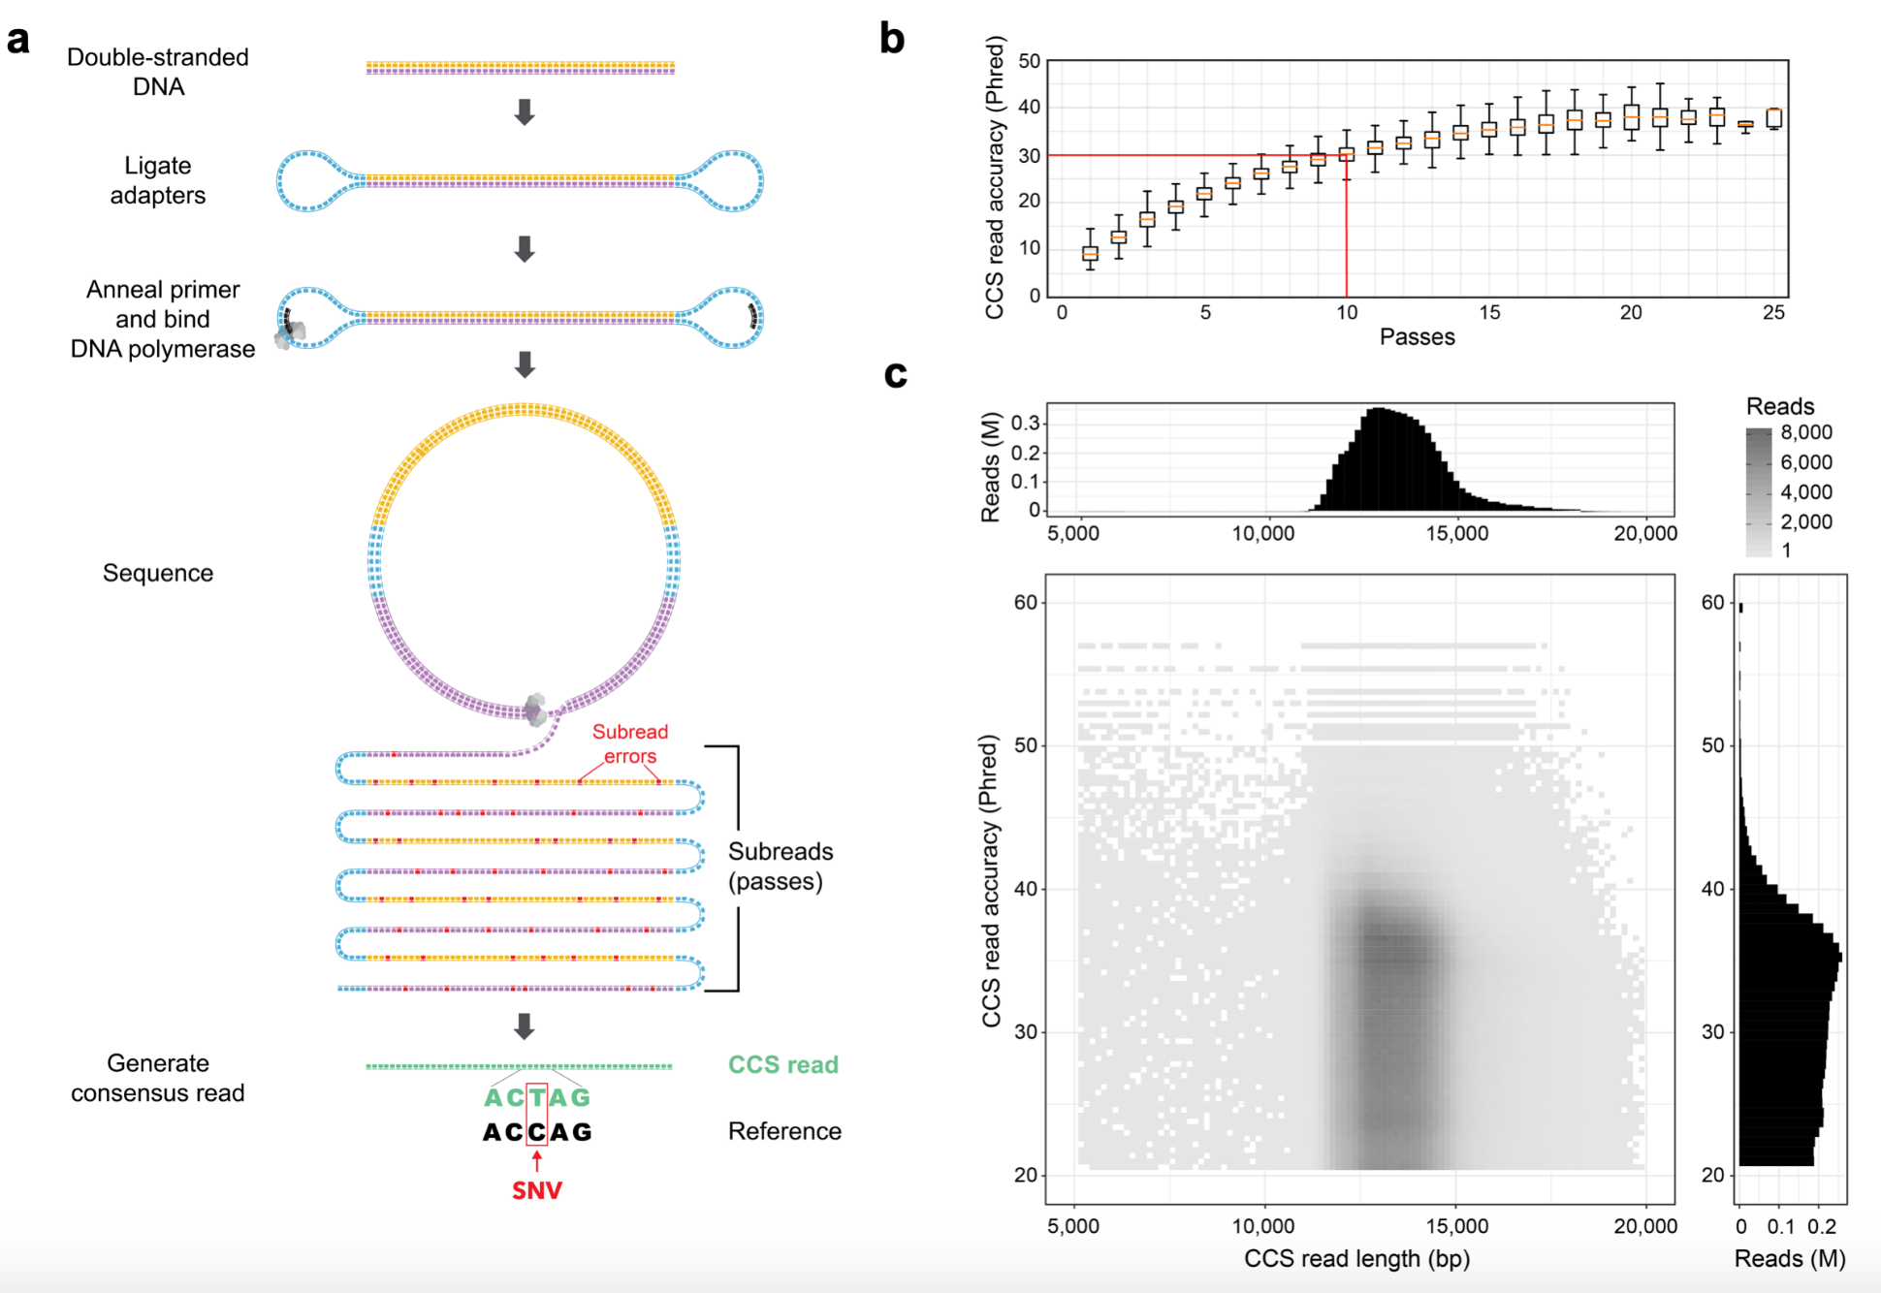
PacBio Circular Consensus Sequencing (CCS)
Wenger, A. M., Peluso, P., et al. (2019). Highly-accurate long-read sequencing improves variant detection and assembly of a human genome. BioRxiv.
Notes:
Circular Consensus Sequencing a recent advance in PacBio reads
Instead of 50 thousand to 100 thousand bp long reads, we have somewhat shorter pieces (10 to 15 thousand) read over and over to produce very accurate reads
This addresses a well-known weakness of the PacBio long reads, which was a lower per-base accuracy
Less limited by sample DNA sizes

Slide 19
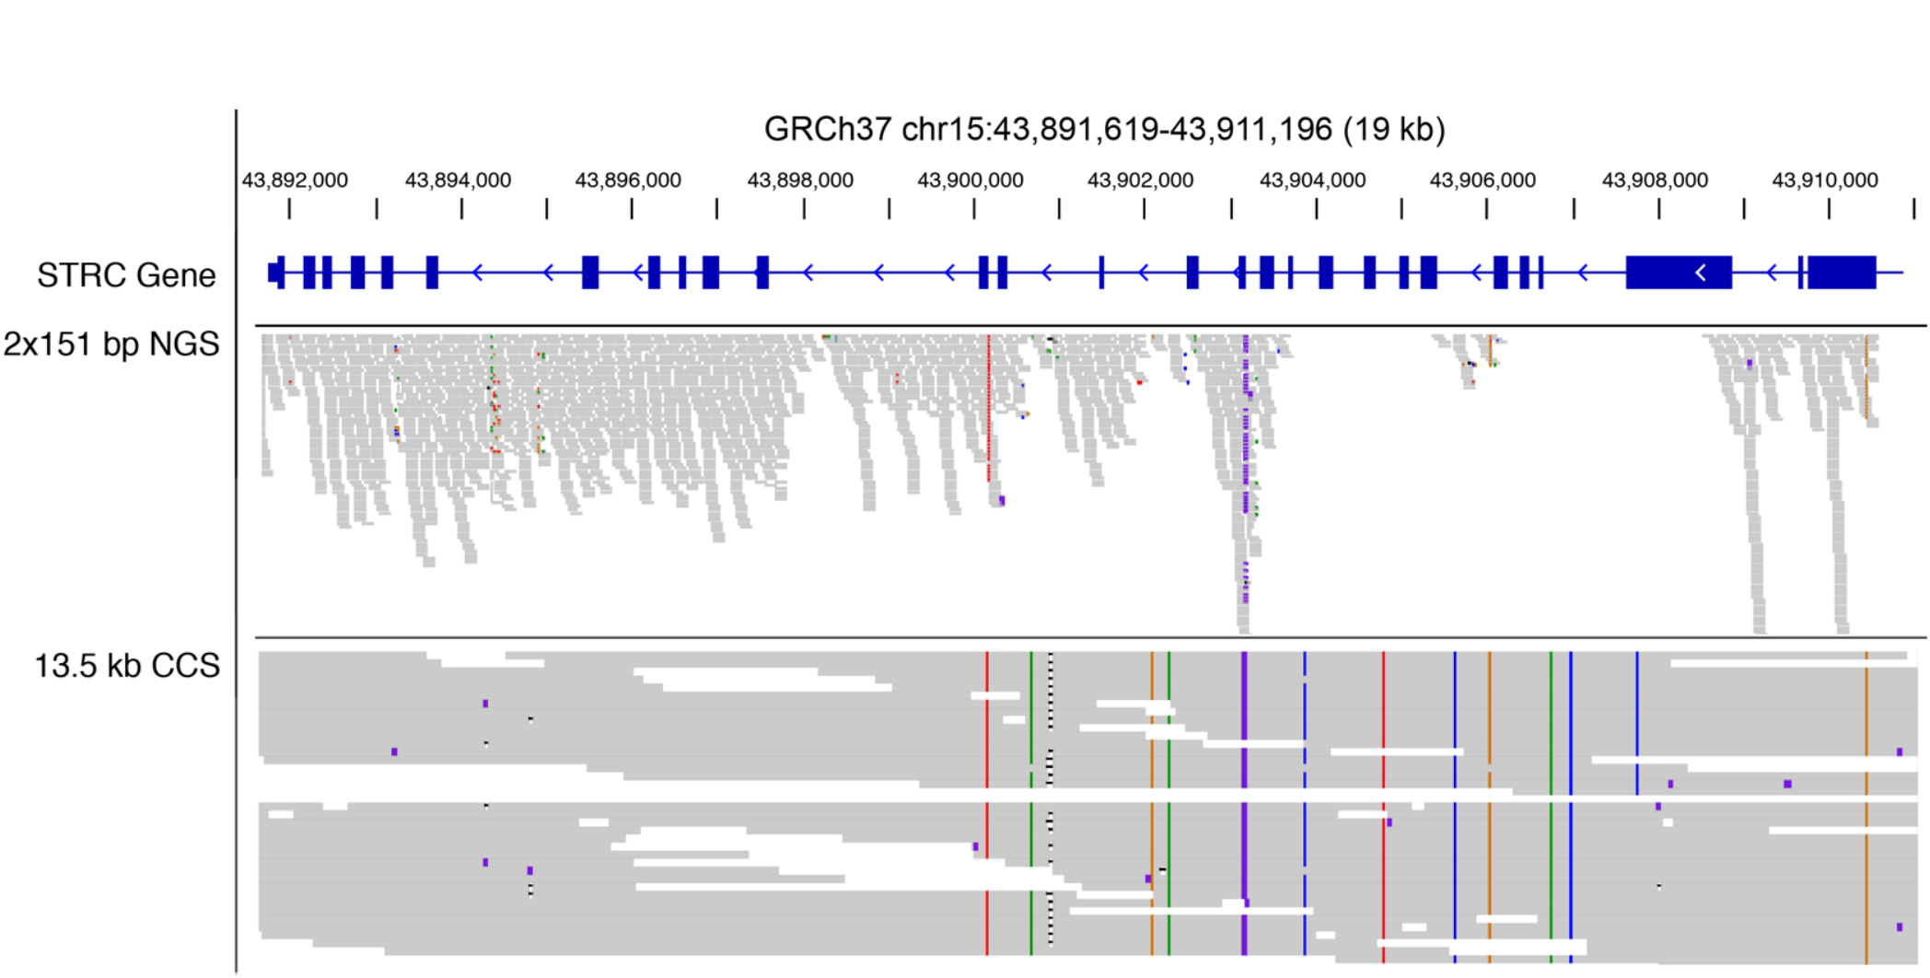
What if we could get longer reads?
Wenger, A. M., Peluso, P., et al. (2019). Highly-accurate long-read sequencing improves variant detection and assembly of a human genome. BioRxiv.

Slide 20
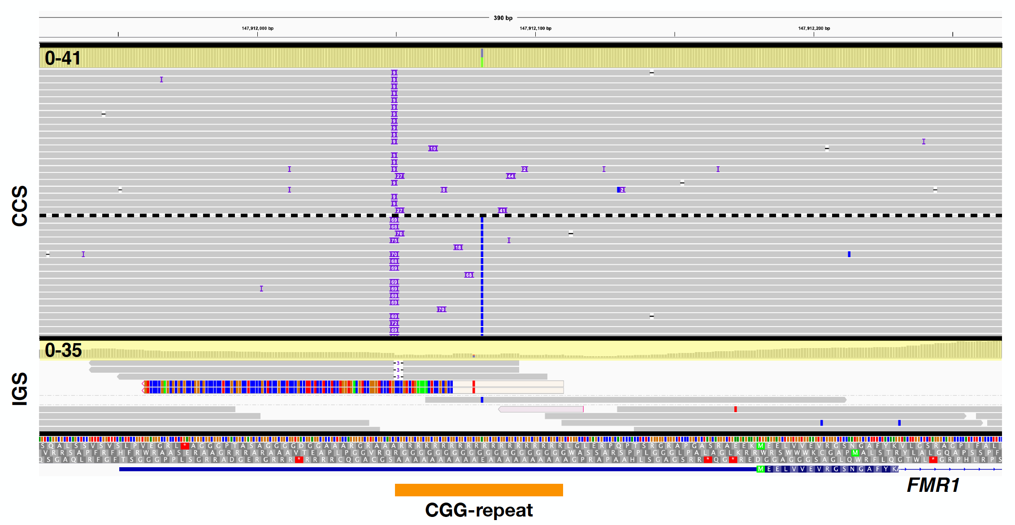
Calls can be made in repeat expansion regions
9 nt insertion
69 nt insertion

Slide 21
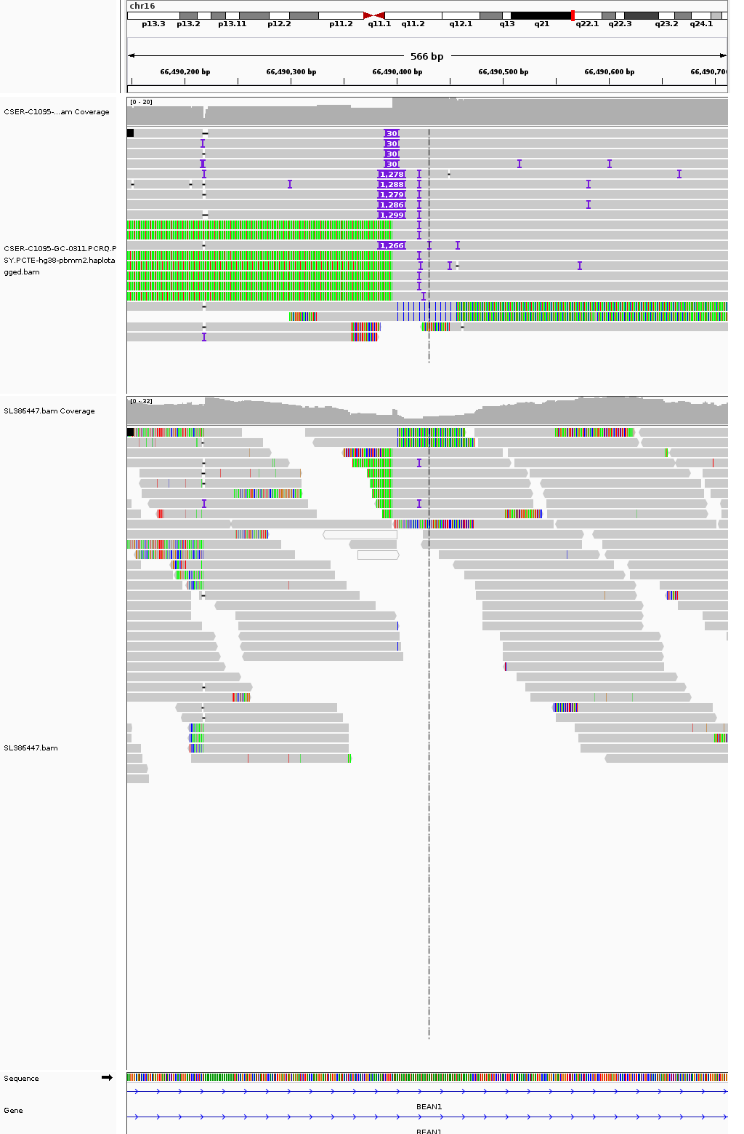
Calls can be made in repeat expansion regions
CCS
IGS

Slide 22
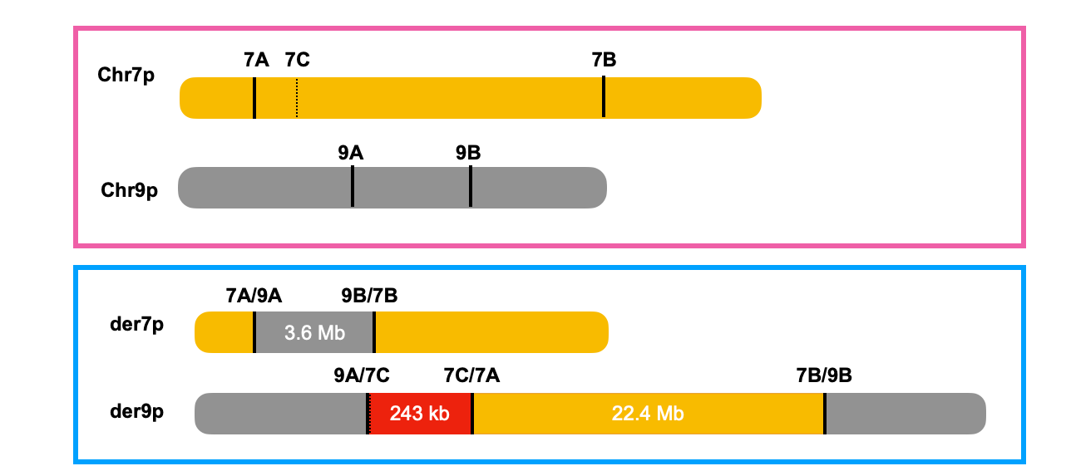
Proband 4 has insertional-translocations affecting chr7 and chr9

Slide 23
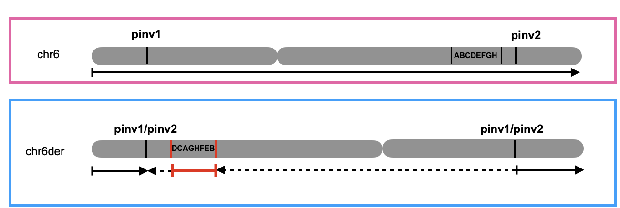
Proband 4 has a pericentric inversion and chromothripsis-like event affecting chr6

Slide 24
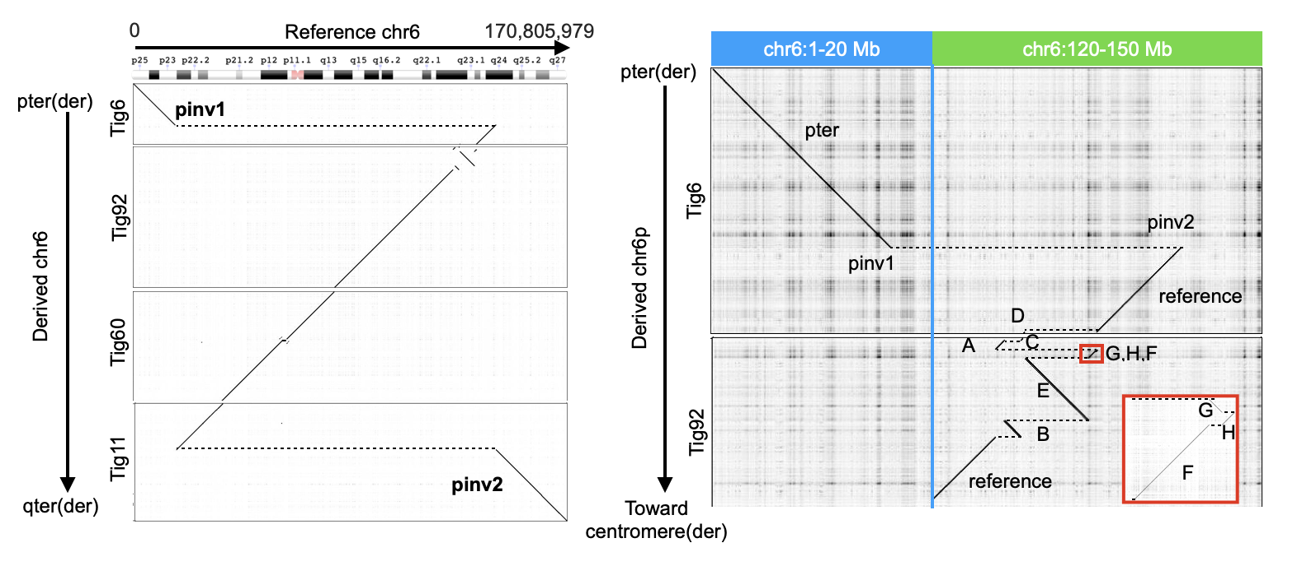
Proband 4 has a pericentric inversion and chromothripsis-like event affecting chr6
*

Slide 25
Analysis
Codicem – Genome-scale clinical analysis and interpretation

Slide 26
CODICEM is a variant analysis platform used by several researches at HudsonAlpha
Ingest variants
Annotate with supporting data
Protein effects
Conservation
CADD
Existing disease/gene association
Filter variants
Team variant curation
Report generation
~4,000,000 variants
~1 causal variant

Slide 27
Variants are filtered by their characteristics
,
5,285,977 variants
4,994,771
Sequencing Quality
≥8 reads, ≥15% reads support allele
187,110
Population Frequency
≤ 0.01%
11,468
Predicted Damaging
Affects Protein OR Top 10th %ile CADD
273
Genomic coordinates near a gene
Exclude Intergenic or Unknown Effect
Manual Review:
Inheritance
Literature
Biology
~1
Notes:
Recall, there are 3-5 million variants per person
Show numbers

Slide 28
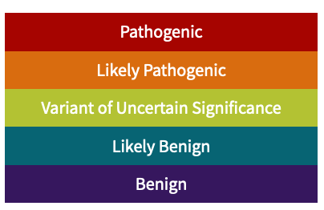
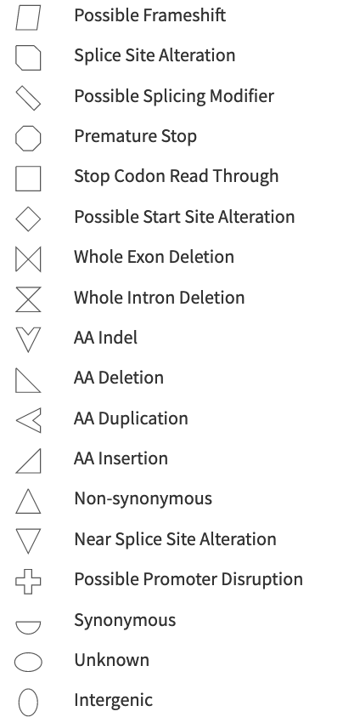
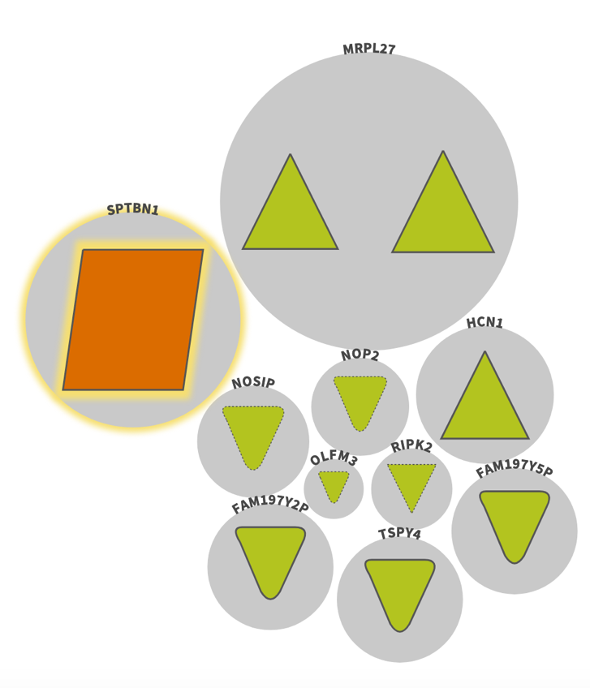
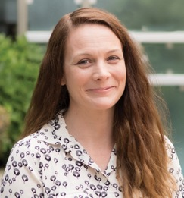
A small set of high-impact variants is amenable to manual review
PI: Liz Worthey, PhD
Notes:
Analysts review for link to phenotypes

Slide 29
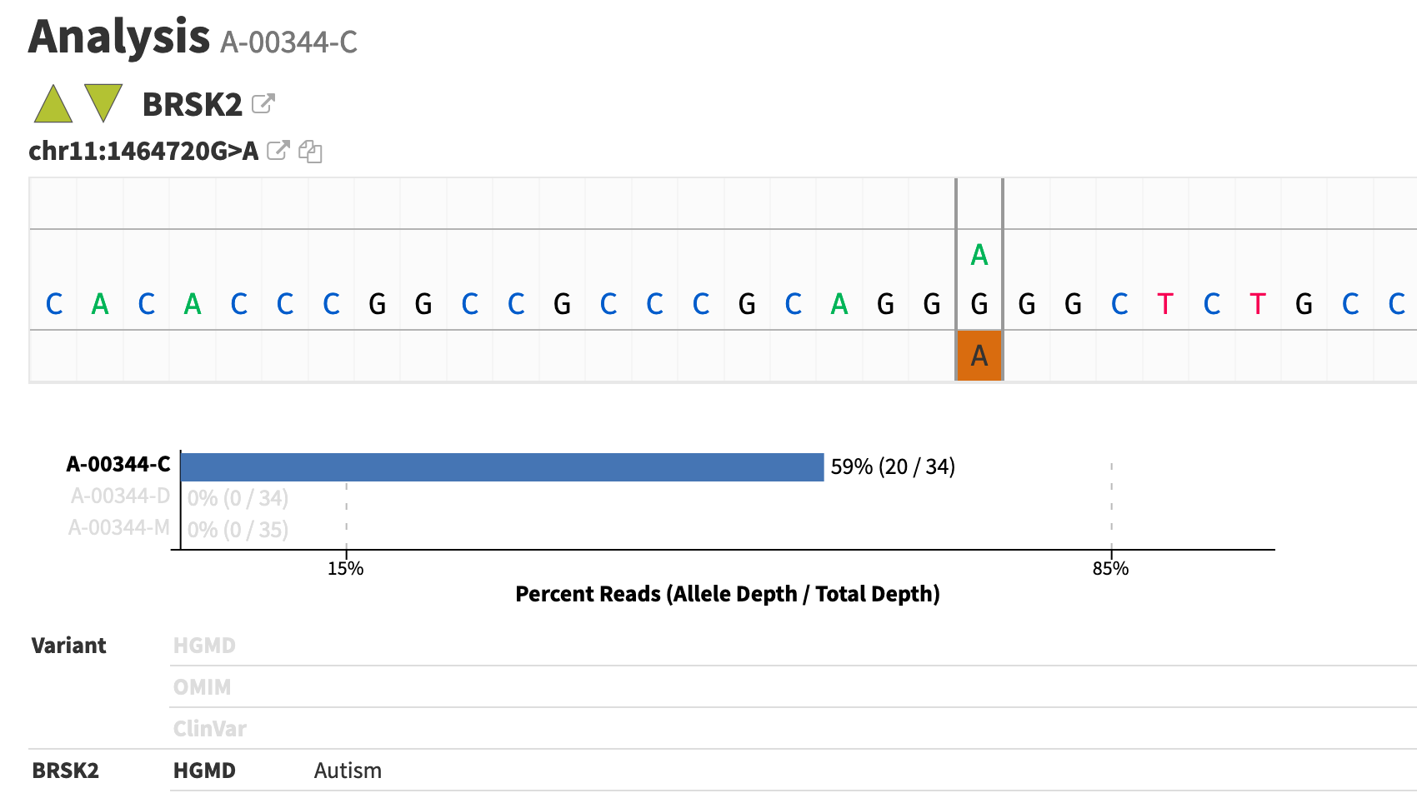
Analysts review filtered variants for potential link to patient’s phenotype

Slide 30
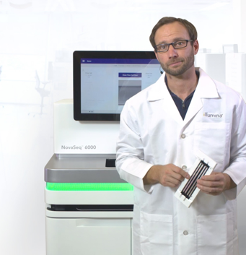
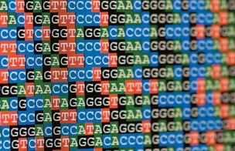
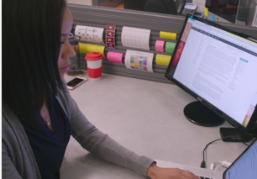
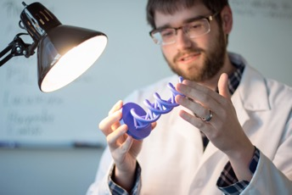
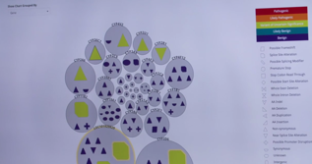
The Challenge
Me
Sequencing lab
Software Developers
Genomic Analyst
Notes:
Me
Sequencing lab
Generates data
Software Developers
Make analysis software
Genomic Analyst
Investigate patient disease & variants

Slide 31

Typical Day
Ask questions:
What can I explore today?
How can I make this process…?
Faster
More reliable
More informative
Evaluate existing tools
Write code
Python
R
Bash
Write about what I did:
For myself
For my collaborators
For the bigger scientific community

Slide 32
Critical Skills
Tech
Science
Communication
Troubleshooting
New languages & tools
Programming
Tech writing
Public speaking
Teamwork
"Translating"
Genetics & Biochemistry
Statistics
Compute clusters
Scientific Literature
Unix
Business Process
Automation
Documentation
Data management

Slide 33
Summary
Bioinformatics skills are critical to providing genetic diagnoses and learning new biology
Genomics requires team science & contributions from diverse skills

Slide 34
Machine Learning

Slide 35
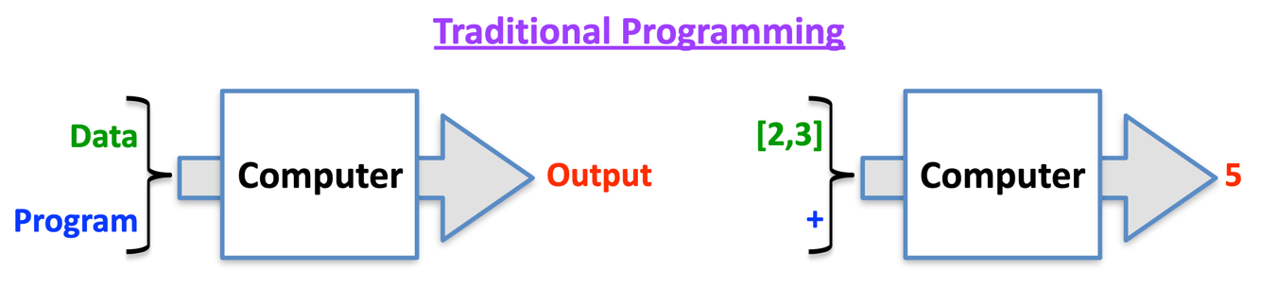
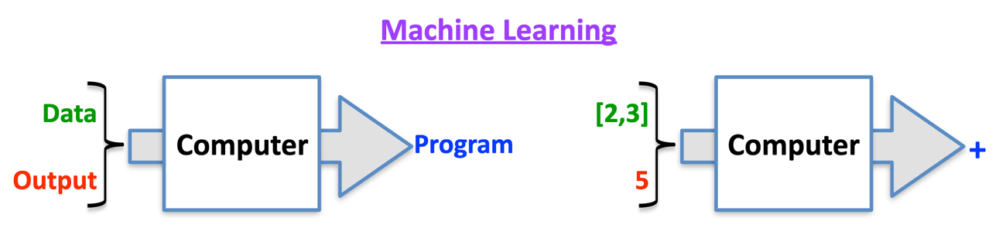
Machine Learning
Data analysis methods to automate analytical model-building
Use data to:
Make predictions
Discover patterns
Useful for complex problems + large amounts of data
Goal: useful not perfect

Slide 36
Example: CADD
CADD – Combined Annotation Dependent Depletion

Slide 37
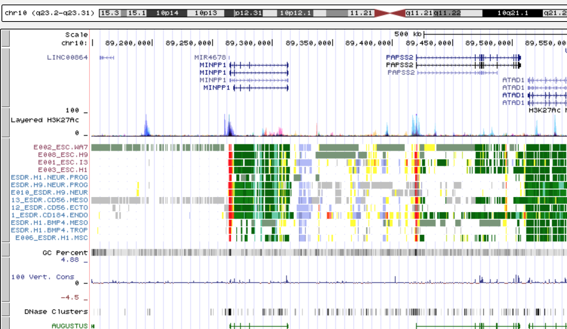
Step 2: Collect Variant Data
>100 annotations, including
Variant effect
Conservation
TFBS Motifs
Biochemical (open chromatin, histone modifications, etc.)
Protein structure
Local SNV Frequencies
Notes:
Variant effect predictions, such as “frameshift” or “regulatory motif disruption”

Slide 38
Step 1: Use evolutionary biology to find variants harmful to humans

Slide 39
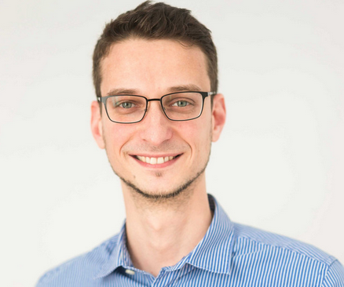
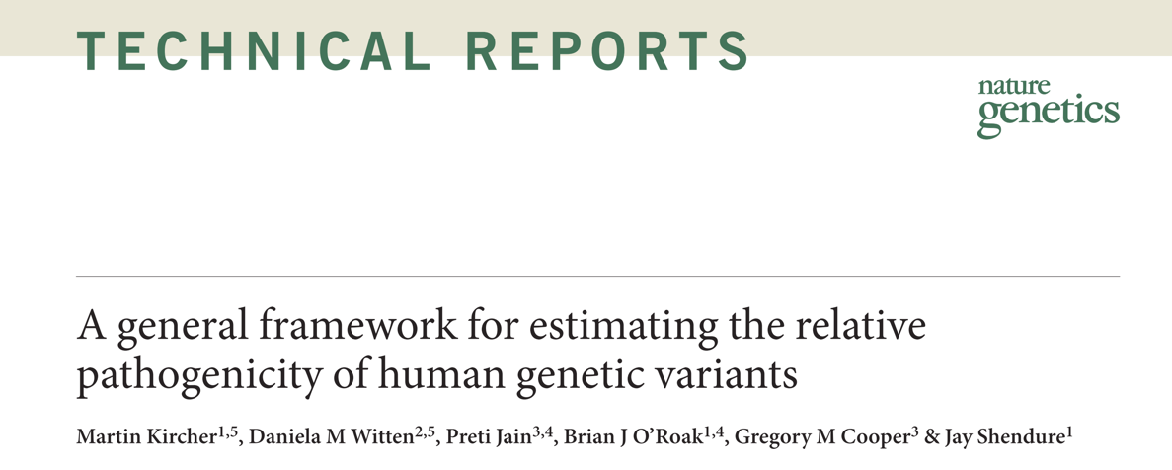
Combined Annotation-Dependent Depletion
CADD:
Predicts deleterious variants
Integrates >100 types of genomic data
Helps prioritize variants
PI: Martin Kircher, PhD
Berlin Institute of Health
Philipp Rentzsch
Notes:
CADD is a computational tool that integrates diverse genomic data to predict deleterious variants.
Published 2014.
We like that it integrates >100 types of genomic data in a reasonably unbiased way. For example, the model includes conservation and protein-coding effects of variants, but it’s not restricted to only dealing with those types of variants.
Deleterious and pathogenic aren’t quite the same thing—deleterious refers to evolutionary fitness and pathogenic refers to clinical disease. But often, the two are strongly correlated and deleteriousness can be a piece of evidence we use in determining if a variant is pathogenic.

Slide 40
Step 3: Computational Model
Regression model learns characteristics of harmful variants
Model ranks all possible variants from least deleterious to most deleterious
Convert to score: CADD 10: Top 10th %ile
CADD 20: Top 1st %ile CADD 30: Top 0.1 %ile

Slide 41
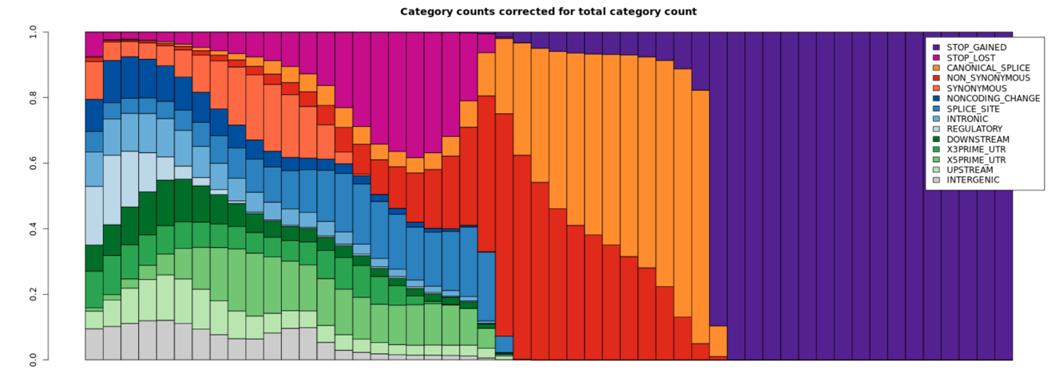
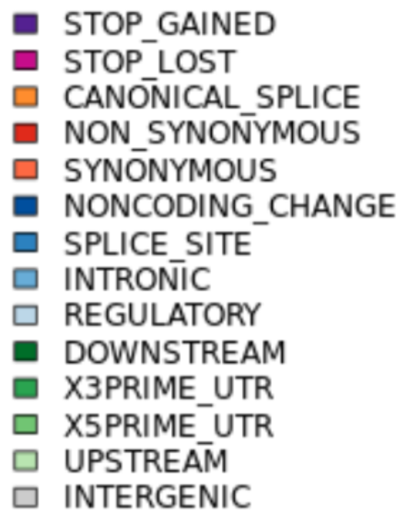
Protein-altering variants have high CADD score
CADD Increasing ->

